Slide 1
Project 5 udacity
Data visualization

Slide 2
Problem statements
what were the causes of the low revenues of 5 genres with least revenue from 2013 to 2017 ?
Was it the budget that causes this drop in revenue ?
Was it the popularity for this genres
Is it the number of movie released in this genres
Is it average time duration of this genre movies ?

Slide 3
Issue tree
what were the causes of the low revenues of 5 genres with least revenue from 2013 to 2017 ?
Average time duration of this genre movies
the average budget of this genre movies
The average popularity of this genre movies
The average number of movies released in these year for this genre

Slide 4
Ghost deck
Overview of analysis
The correlation of the revenue with other to find the most impacting features in the revenue
The features with strong correlation value with the revenue are :
Budget
Popularity
Vote-count
The features with weak correlation value with the revenue are :
Runtime
Vote-average
# of released movies
Hypothesis-1:The drops in revenue is related to the low genre movies budget
Analysis:
the average budget per genres for the years 2013 to 2017
Relation between revenue and budget
Synthesis
The possible cause for the drop in the five genres with the least revenue between 2013 and 2017 is related to the number of released movies under this genre, the average budget of these genres, the popularity and the movies' average duration.
Recommendation :
Increasing the budget of these types of movies and doing advertising campaigns to increase their popularity
Hypothesis-2:The drops in revenue is related to the genre movies low popularity
Analysis:
The average popularity of genres for the years 2013 to 2017
Relation between revenue and popularity
Hypothesis-3:The drops in revenue of the genre is related to the small number of released movies
Analysis:
The average # of released movies per genres for the years 2013 to 2017
Relation between revenue and # of released movies
Hypothesis-4:The drops in revenue of the genre is related high or low runtime of the genre movies
Analysis:
The average runtime of genres for the years 2013 to 2017
Relation between revenue and runtime
Limitations
The dataset has many missing value and mismatch in the data
Only consider the features such as budget,popularity and duration time .
The distribution of some of the variables is skewed
Next step
Handling the data skewness and missing data
investigating other features as the release date ,cast ,language,production country and production company

Slide 5
Executive summary
The genres with least revenue in the period of 2013 to 2017 are :'Horror', 'Music','Documentary', 'Foreign', 'TV Movie'
The causes for the drop in the five genres with the least revenue between 2013 and 2017 in order of significant are:
The low average budget of these genres,
The low average vote count of this genres movies
The low average popularity of this genres movies
Recommendation :
Increasing the budget of these types of movies and doing advertising campaigns to increase their popularity

Slide 6
Overview of analysis
What are the causes of the low revenues of 5 genres with least revenue from 2013 to 2017 ?
Find the 5 genres with the lowest revenue in the period 2013-2017
Using the correlation to find the most correlated features with the revenue
The features with highest correlation with the revenue in order are :
Budget
Vote count
Popularity
Release year
Runtime
So how these features affect the drop in these genres revenue ?
Is it the budget that causes this drop in revenue ?
Is it the popularity for this genre movies ?
Is it the number of movie released in this genres?
Is it average time duration of this genre movies ?

Slide 7
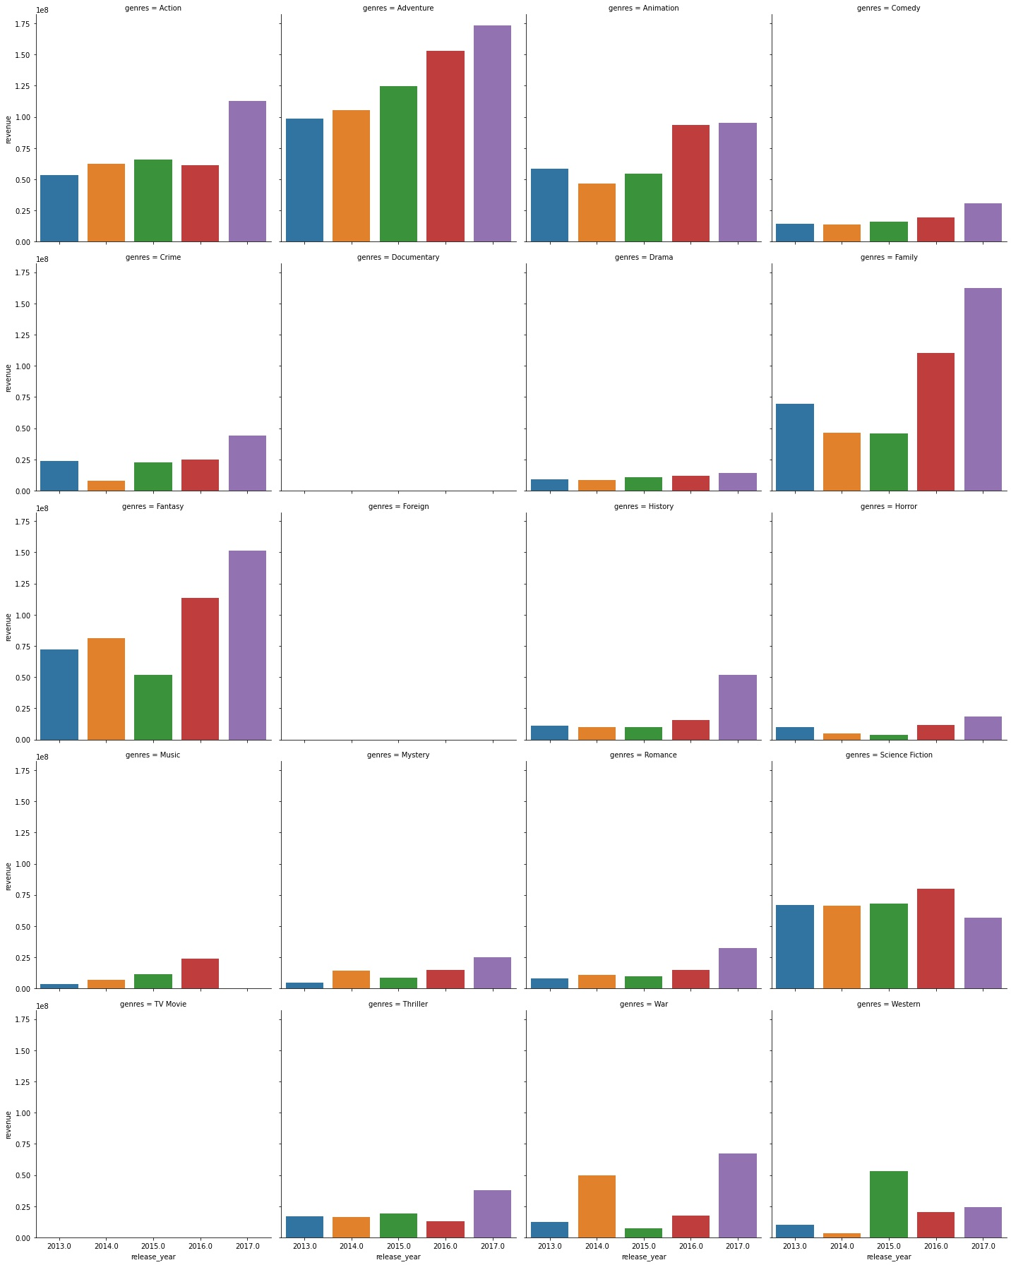
The genres with least revenue form 2013 to 2017
The genres with least revenue in the period of 2013 to 2017 are :'Horror', 'Music','Documentary', 'Foreign', 'TV Movie'
Foreign and TV Movie have an average of zero revenue during these years
No movie of genre forign is present in the data during the years 2015,2016 and 2017

Slide 8
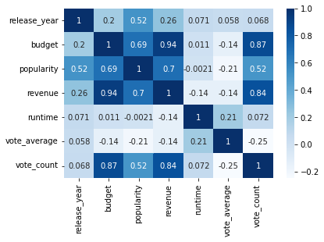
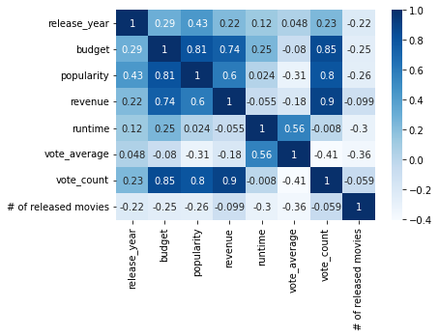
Correlation between revenue and other variables
All genres correlation matrix
Horror', 'Music','Documentary', 'Foreign', 'TV Movie' genres correlation matrix
The revenue of the five least revenue genres correlation matrix have less correlation with budget, popularity than all genres correlation matrix
Vote count has the highest correlation with revenue for the five genres
Vote count , budget and popularity have strong positive correlation with the revenue
Both number of released movies and runtime have very weak negative correlation with revenue

Slide 9
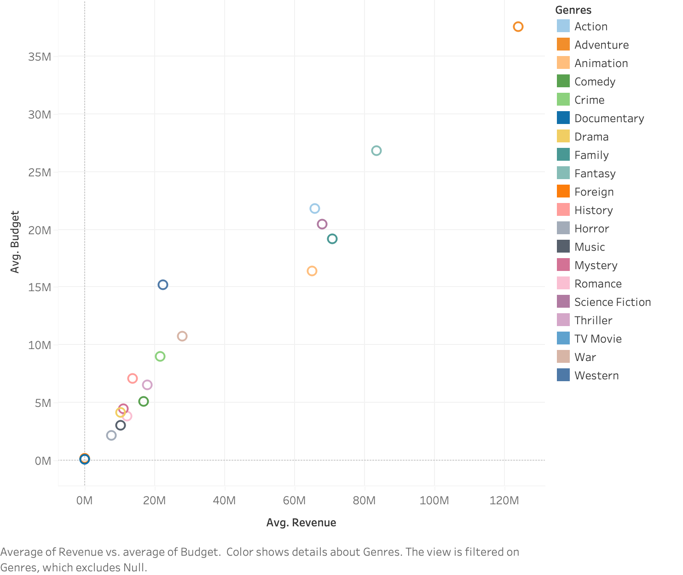
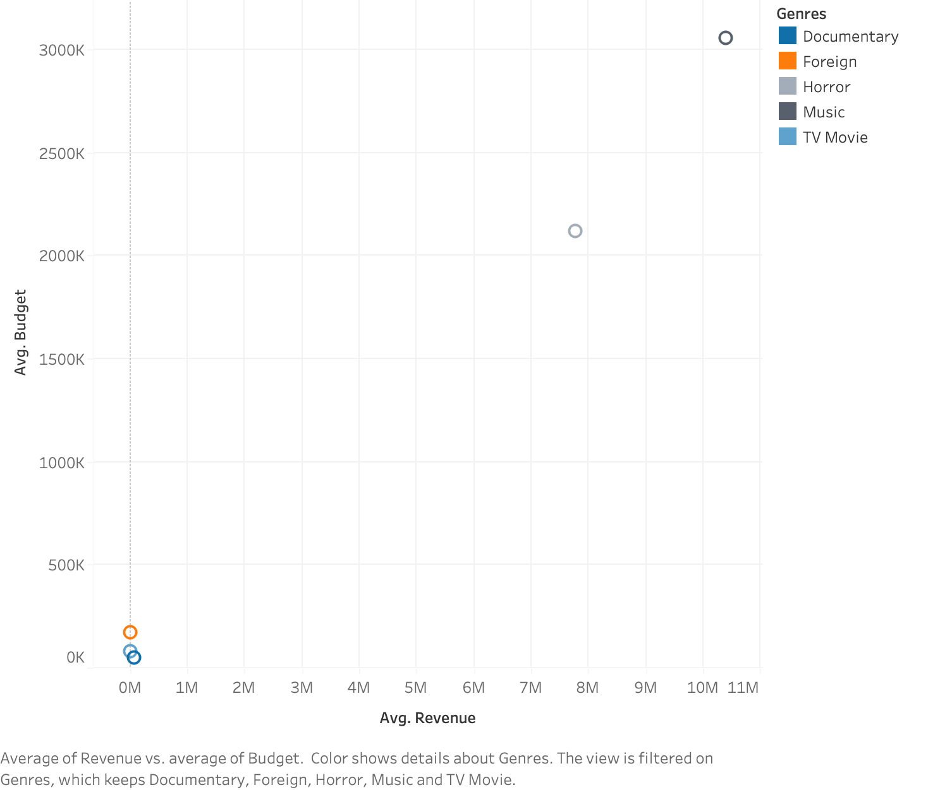
The budget in relation with the revenue
There is positive strong relation between the revenue and budget
All the five genres have the least budget among all
TV movies ,foreign and documentary genres have the least budget.
Although documentary movies have the least budget ,their revenue is higher than foreign and tv movies

Slide 10
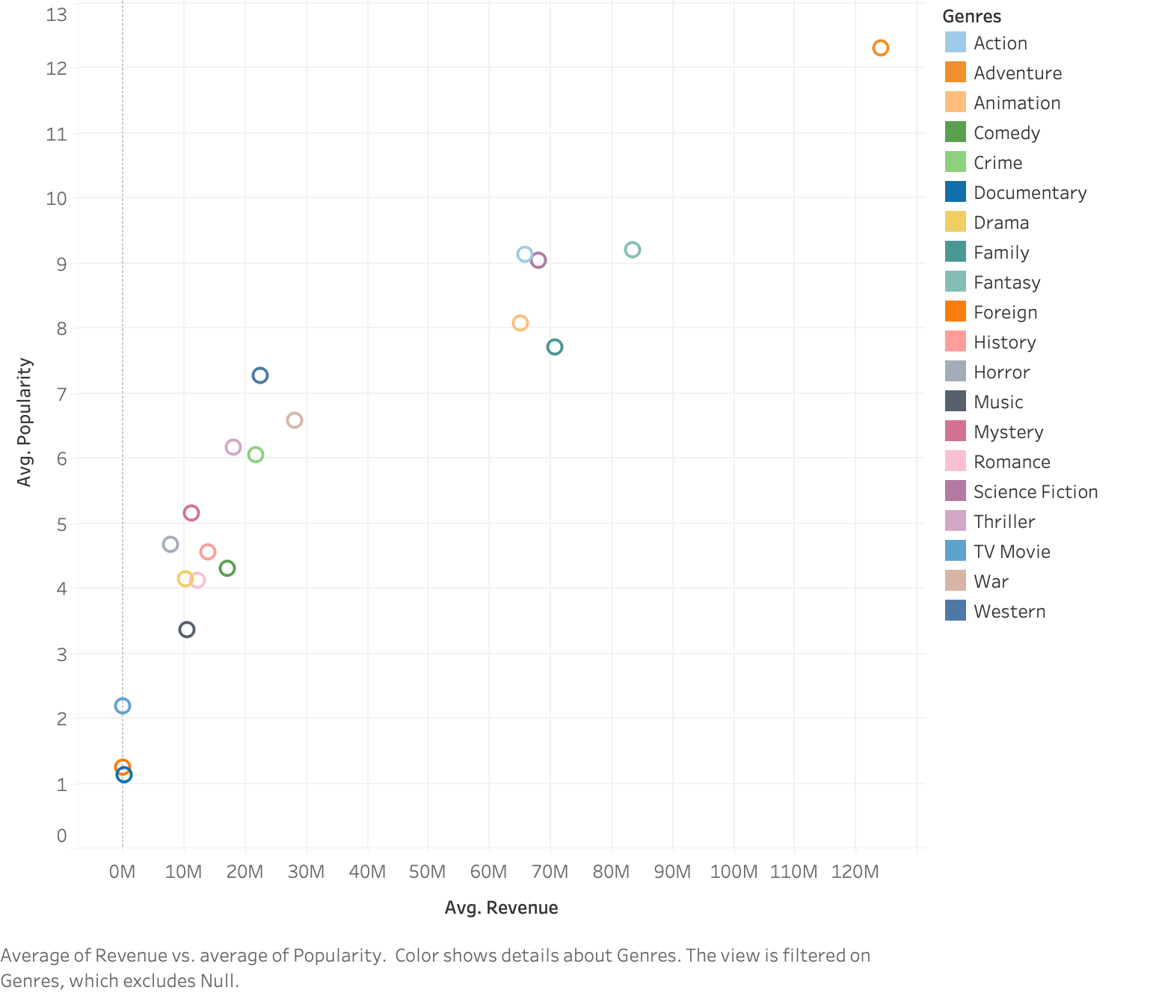
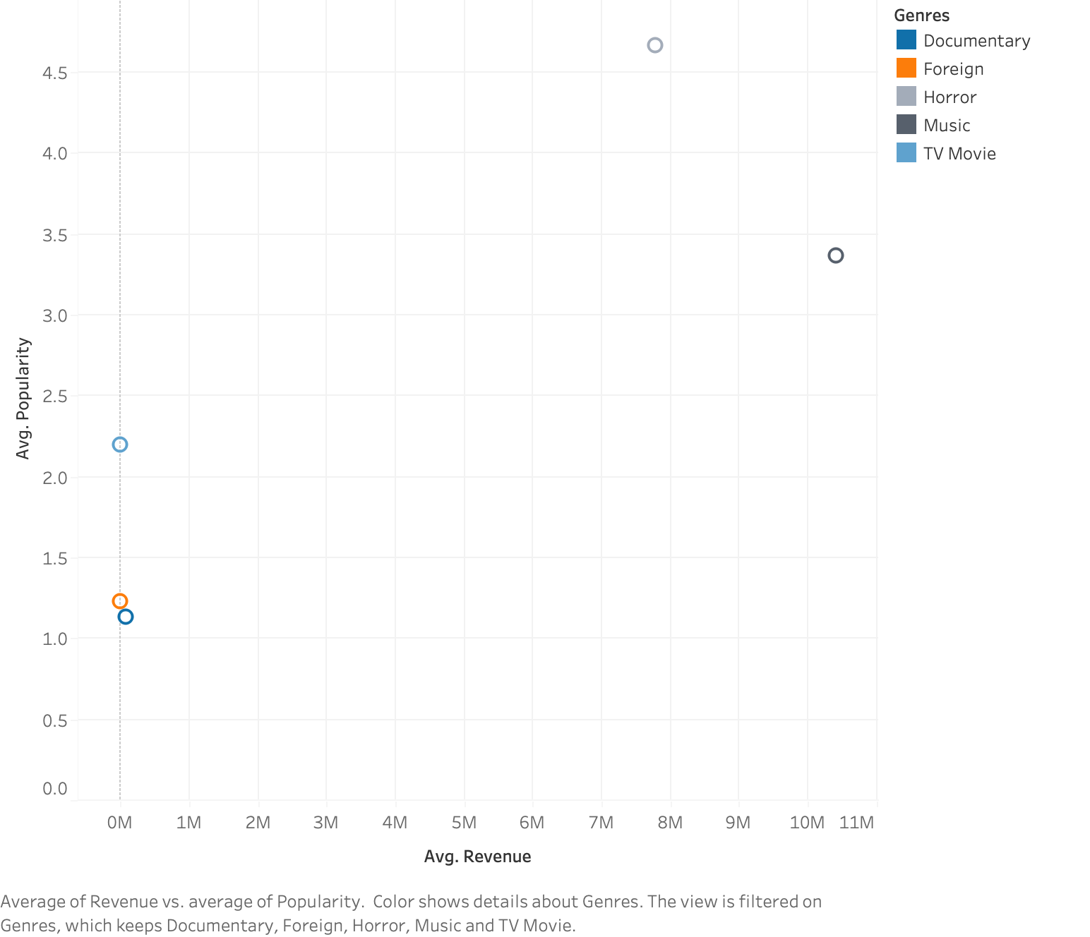
The popularity in relation with the revenue
There is positive strong relation between the revenue and popularity
All the five genres except the horror have the least popularity among all
Despite being more popular than music, history, comedy, romance, and drama, the horror genre generated less revenue than those other genres.

Slide 11
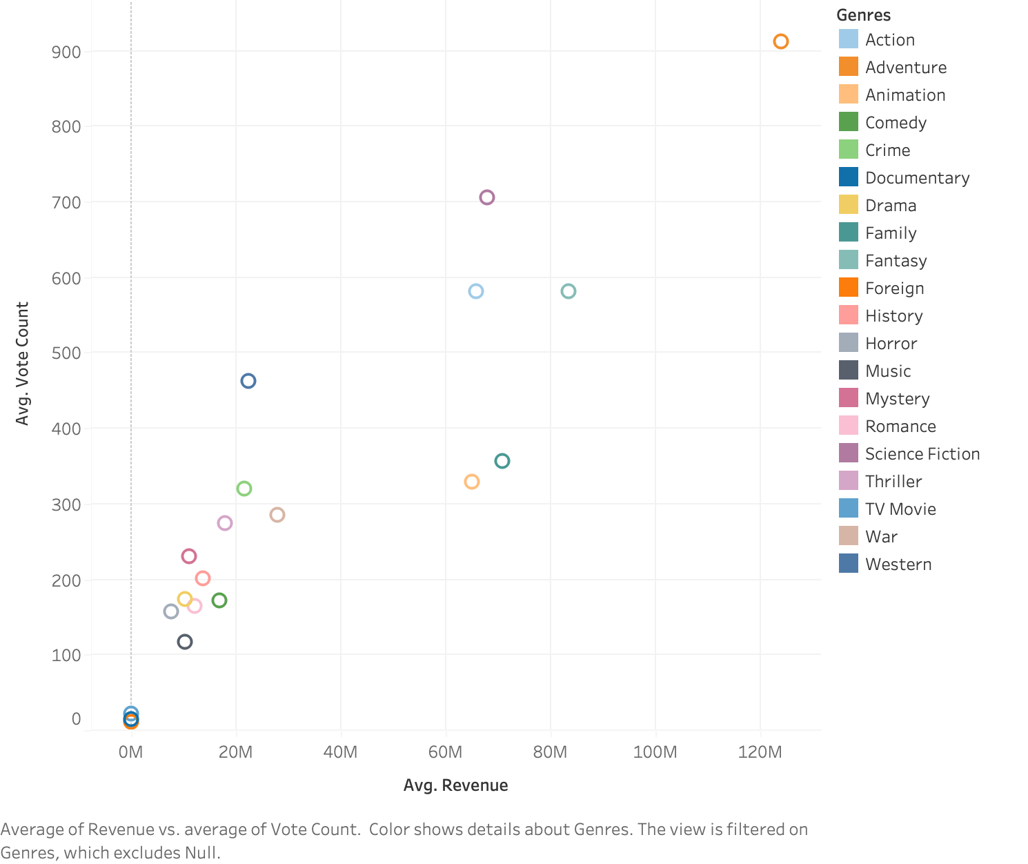
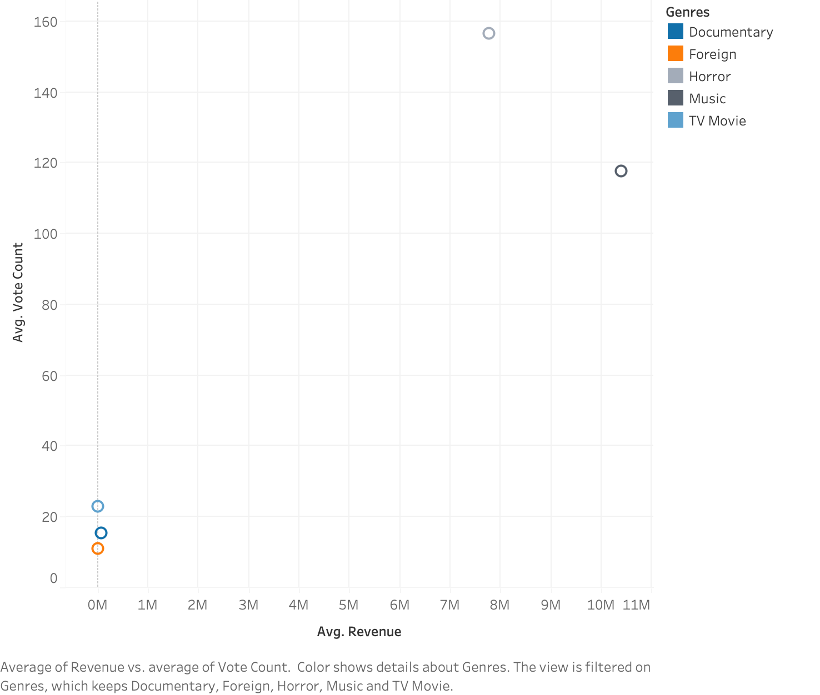
The vote count in relation with the revenue
There is positive strong relation between the revenue and vote count
All the five genres have the least vote count among all genres
Foreign , Tv movies and documentary have very low vote count with 22 or less

Slide 12
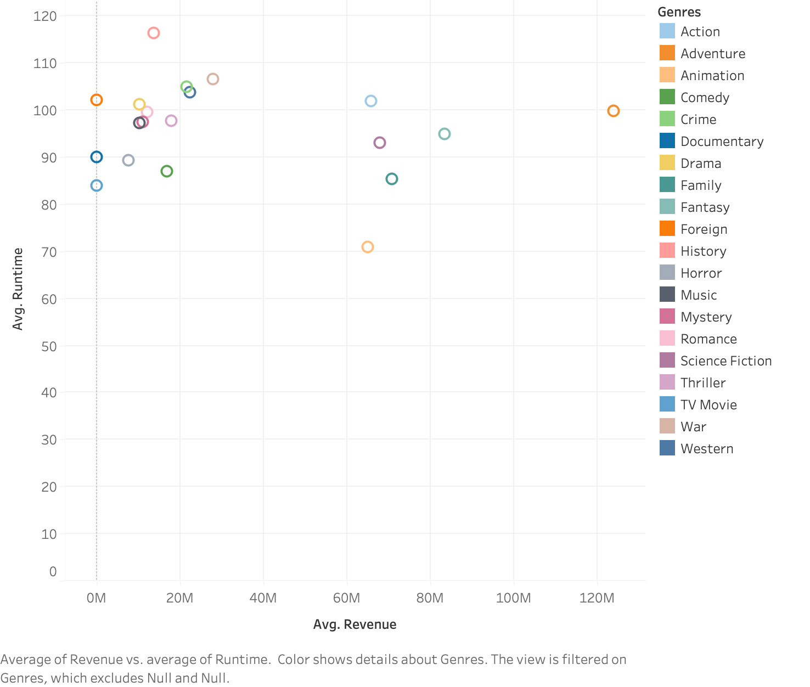
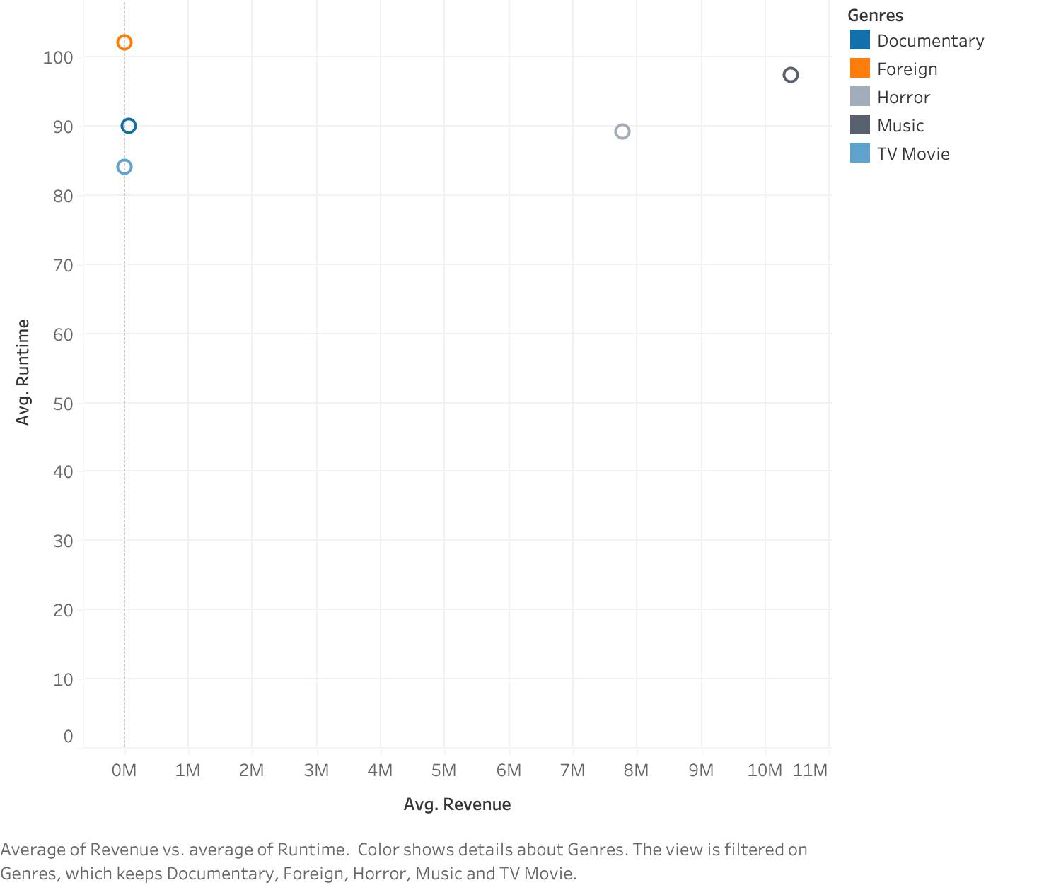
The runtime in relation with the revenue
There is no clear relation between revenue and average runtime of the genre movies
All five genres have a varied runtime, with foreign runtime among the highest-runtime genres while having no revenue.
The genres with the shortest runtimes include TV movies, which also had no revenue.

Slide 13
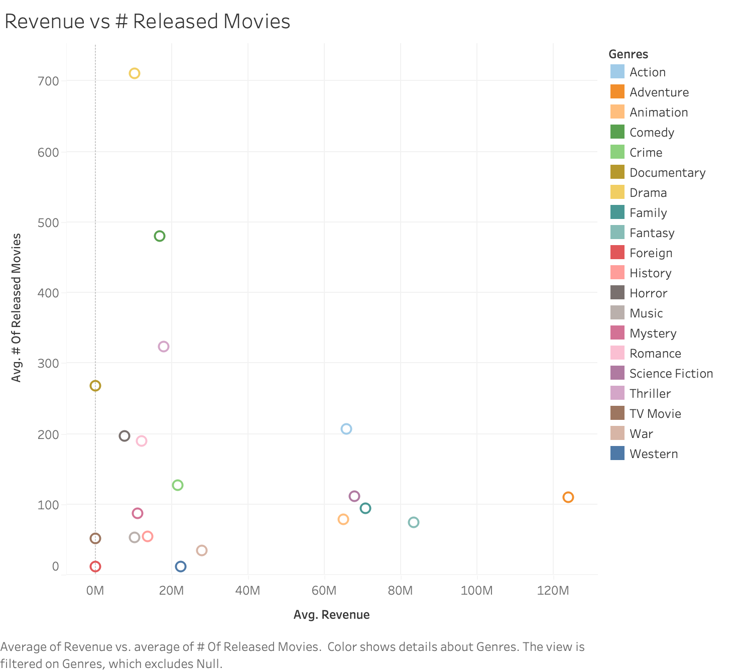
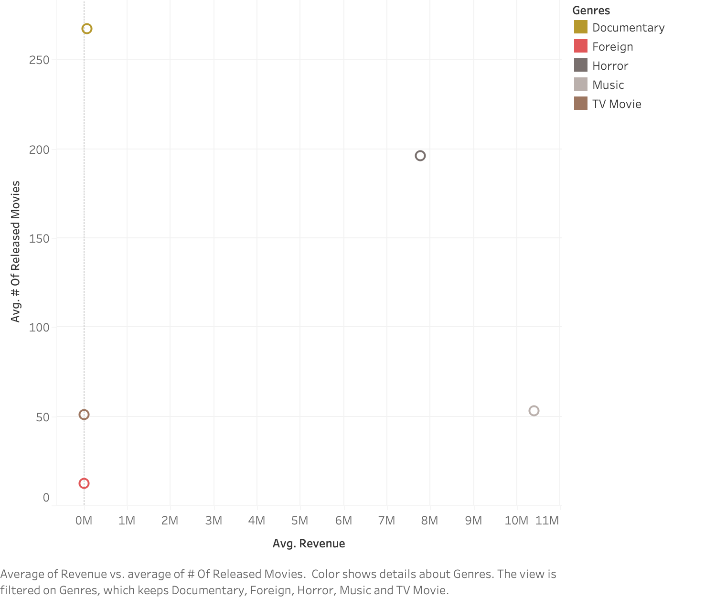
The number of released movie in relation with the revenue
There is no clear relation between revenue and number of released movies
The number of released movies of foreign genre is only about 12 movie hence it apparent that it has nearly zero revenue during this period
Although Tv Movies have about 50 movies released none of it obtained any revenue
Despite the number of documentary released movies which is 267 , it only obtained an average of nearly 80.000 $

Slide 14
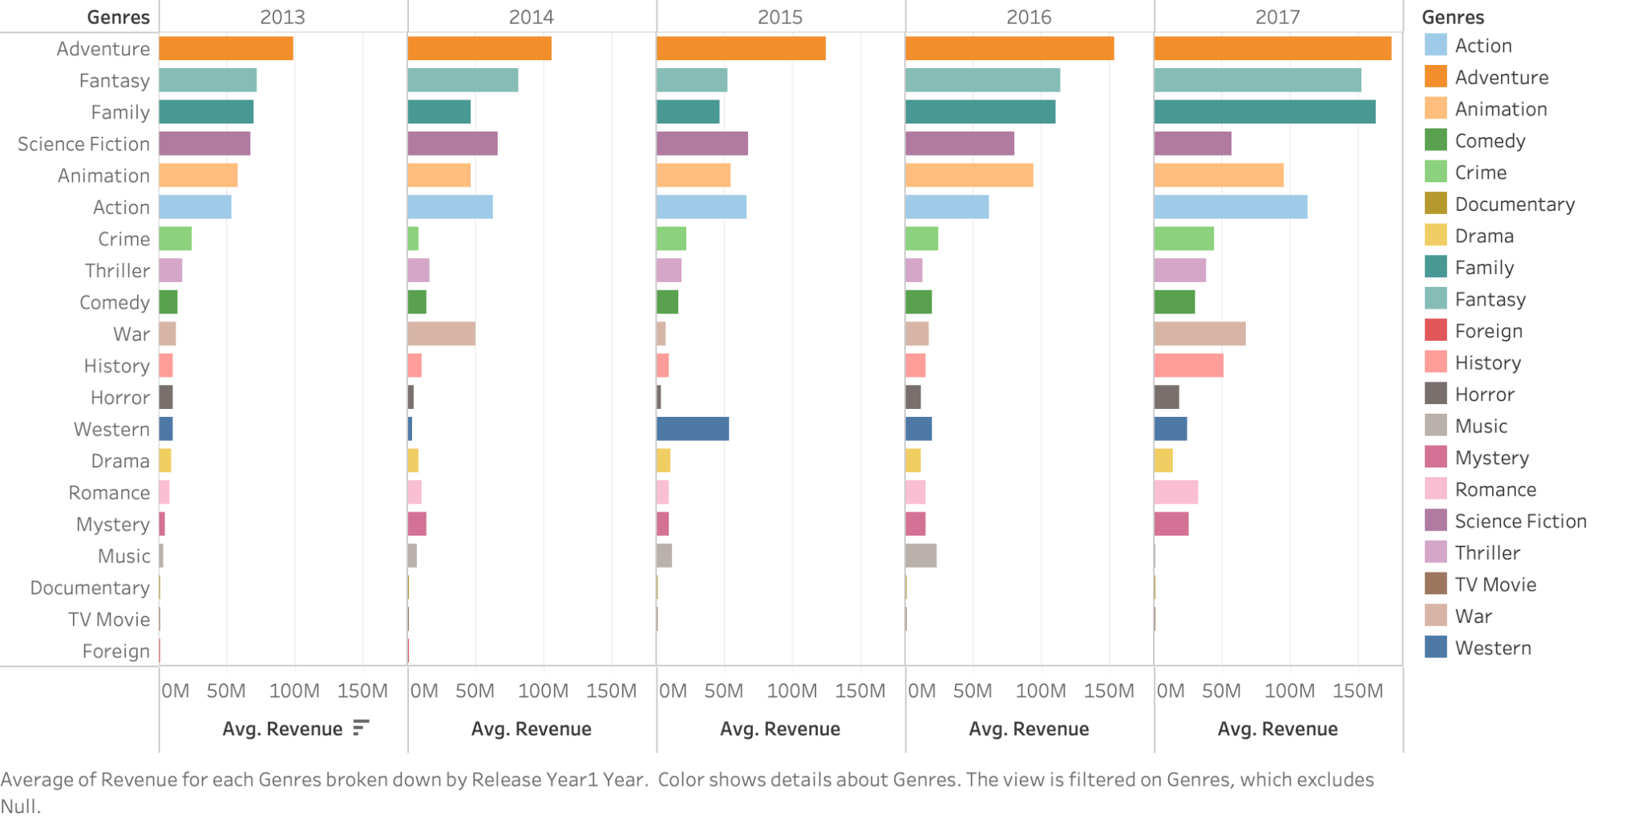
Revenue by Genres and Released Year
Foreign and TV movies generated no revenue during the five years.
Even though the music genre revenue increases from 2013 to 2016 , it havely drop in 2017
Horror movies revenue have dropped in 2014 and 2015

Slide 15
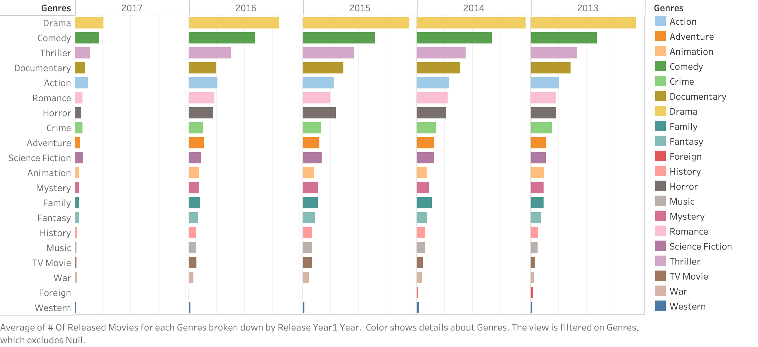
Number of released movies by Genres and Released Year
No movies were released for foreign genre in 2013, 2014, or 2015.
There is no clear relation between the number of released movies and the revenue.
The number of released movie genres, documentary and horror, kept increasing during the years and exceeded many genres with higher revenue, such as Adventure, Fantasy and Family.
Even though genres like western don't have the least revenue, it has the least number of released movies from 2013 to 2017

Slide 16
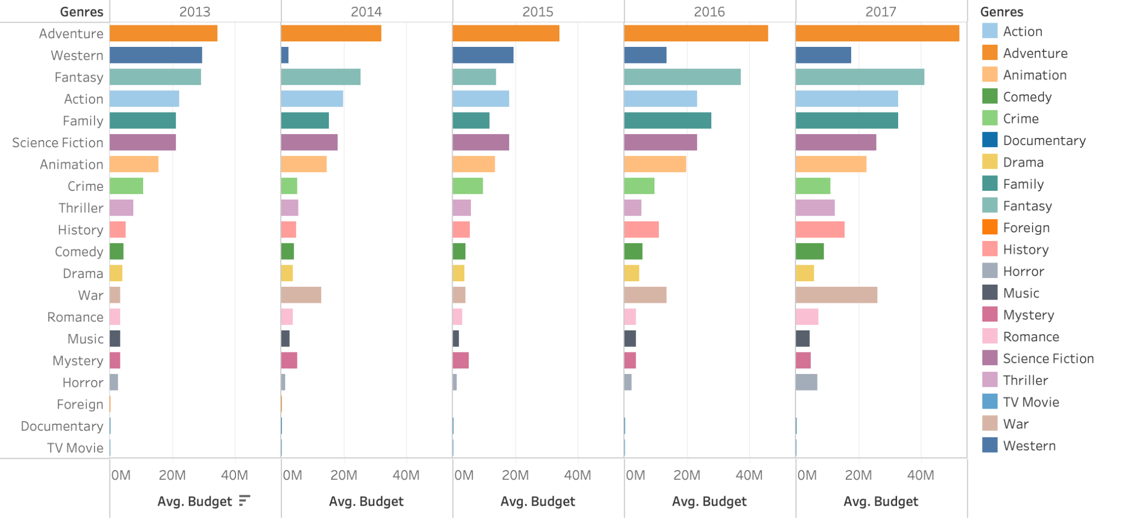
Budget by Genres and Released Year
Foreign genre have budget only in 2013
Tv movies , documentary and foreign genre have the least budget during all the years
The horror genre also had lower budgets generally, with the exception of 2017, which also reflected in its revenue during this year, when horror made the most revenue.

Slide 17
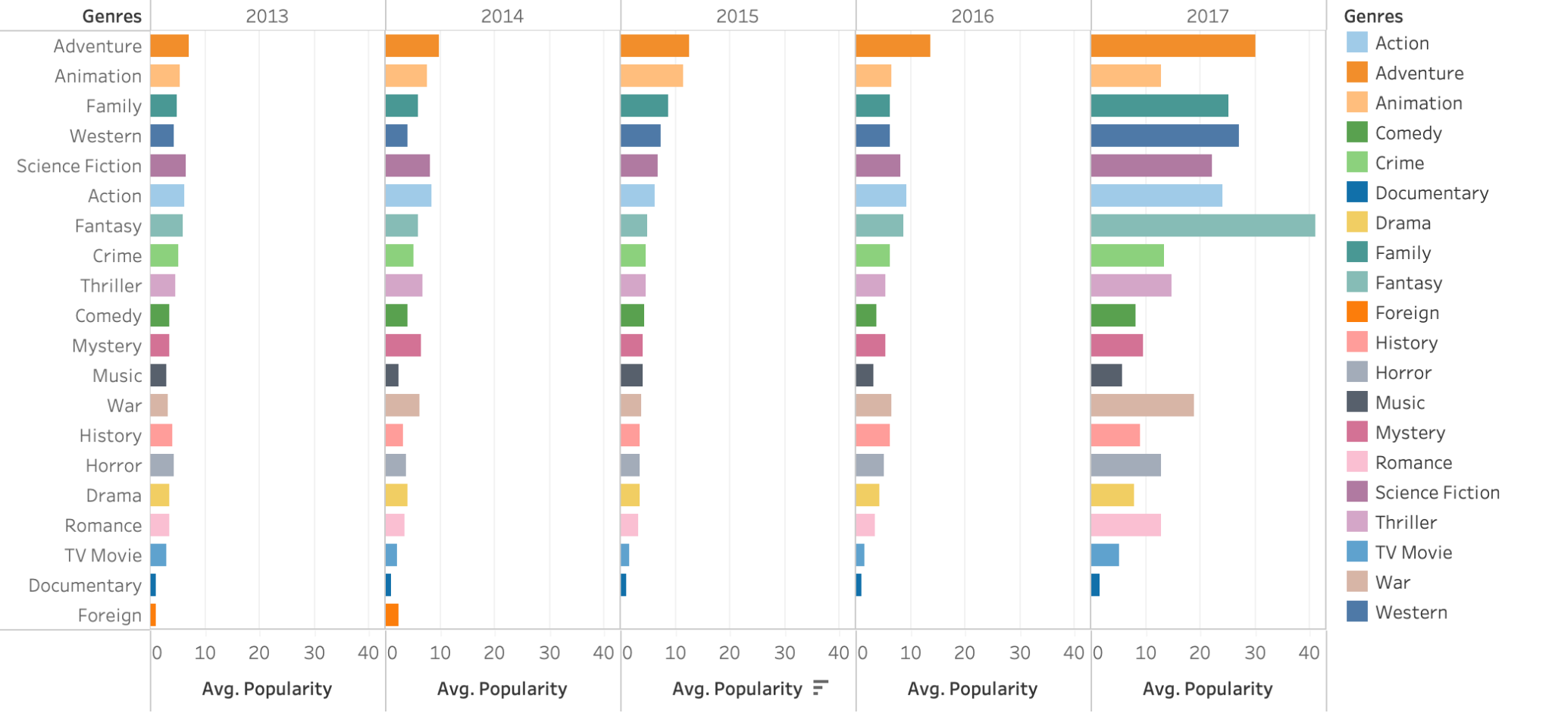
Popularity by Genres and Released Year
Tv movies ,documentary ,foreign and music genres have the least popularity on most of the years.
Despite receiving less revenue than other genres like drama and romance, the horror genre is more popular than either of those two.

Slide 18
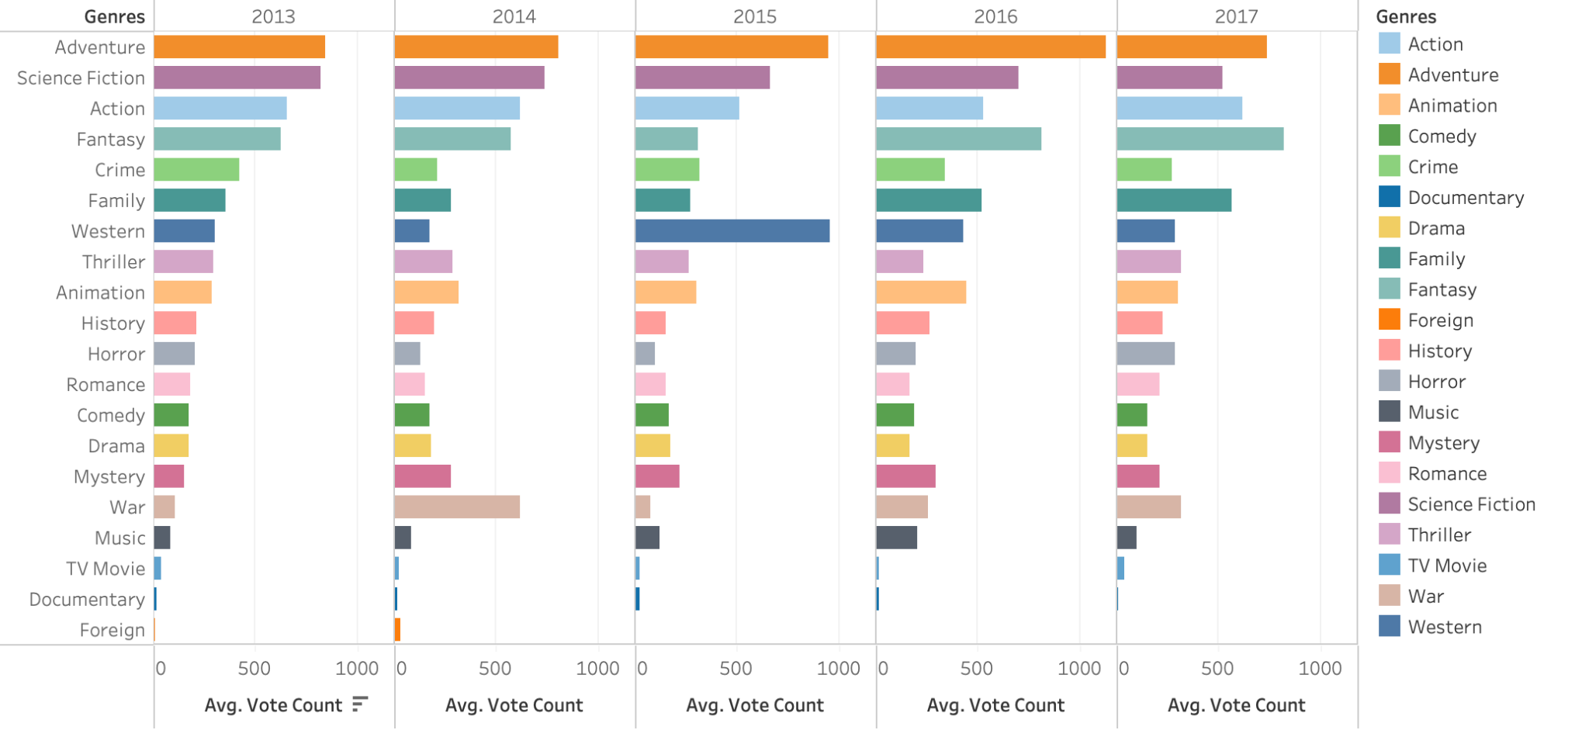
Vote count by Genres and Released Year
Tv movies ,documentary ,foreign and music genres have the least vote count on most of the years.
The horror genre receives more votes compared to drama, comedy, and romance even though it generates less revenue.

Slide 19
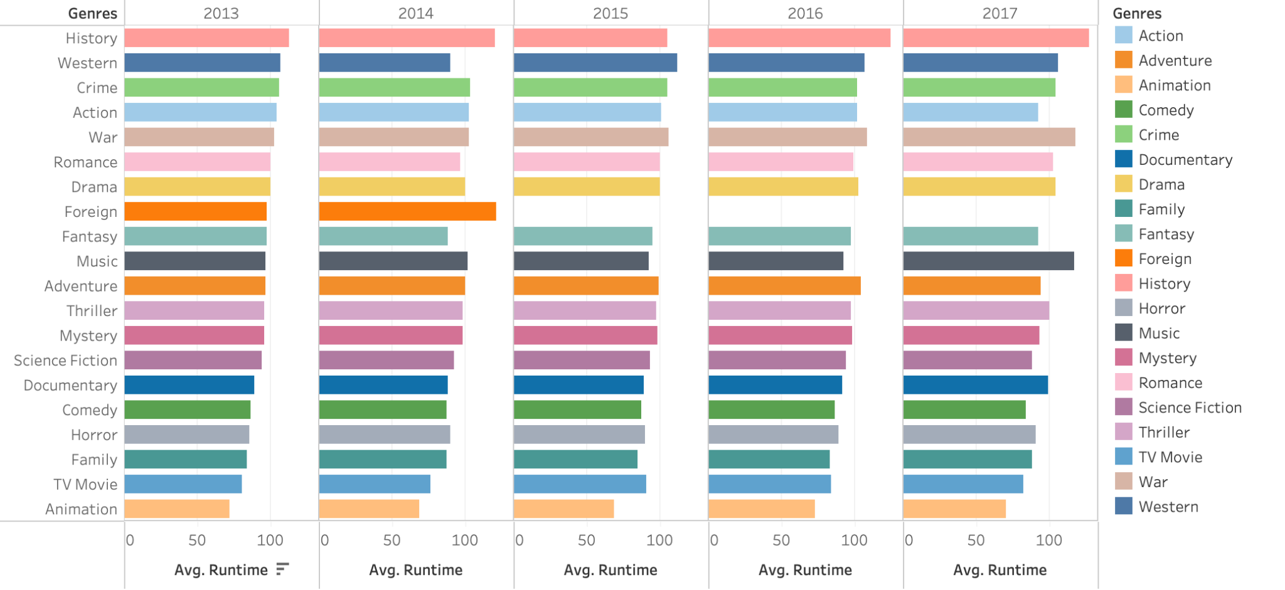
Runtime by Genres and Released Year
There no clear distinction between low and high revenue genres regrading runtime

Slide 20
Bias and Limitations
The dataset has many missing value and mismatch in the data
Only consider the features such as budget,popularity and duration time .
The distribution of some of the variables is skewed

Slide 21
Data Collection Bias

Slide 22
Missingness bias
No data available for foreign genre in the years 2013 ,2014 and 2015
Number of missing values in each columns
adult 0
belongs_to_collection 40972
budget 0
genres 0
homepage 37684
id 0
imdb_id 17
original_language 11
original_title 0
overview 954
popularity 5
poster_path 386
production_companies 3
production_countries 3
release_date 87
revenue 6
runtime 263
spoken_languages 6
status 87
tagline 25054
title 6
video 6
vote_average 6
vote_count 6
As can be seen the number of missing values is high in some columns as belongs_to_collection ,homepage ,however we don't use these columns in our analysis so we ignore it .The number of missing values of the variables that we use in our analysis such as revenue and runtime is small compared to the dataset size so its effect is negaticable.
Survivorship Bias
Only data from 2013 to 2017 were consider in analysis with 5 genres of lowest revenue
Mismatch of the data with data columns
To solve this we drop any row with adult column value not True or False ,since these rows have mismatch

Slide 23
Data processing Bias

Slide 24
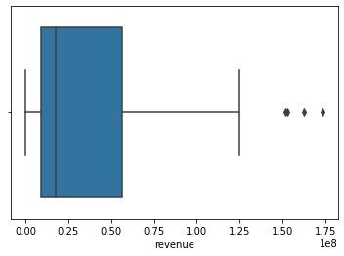
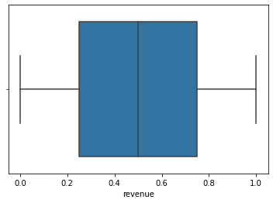
Data processing Bias
● Distribution Understanding
The revenue distribution per year and genre skewed into the right and have outliers.
To overcome the outlier we calculate the Interquartile range to find the lower and upper bound and remove any number above it or below it. Sklearn Quantile Transformer used to solve the skewness in the data
mean 36859131.635
std 40868448.932
min 0.000
25% 9106715.963
50% 17721537.188
75% 56436314.593
max 173449081.769
IQR: 47329598.63001403
Upper bound : 127430712.53824139
Lower bound : -61887681.98181474
To overcome the outliers

Slide 25
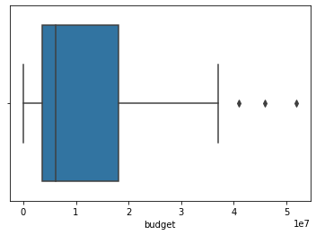

Data processing Bias
● Distribution Understanding
The budget distribution per year and genre skewed into the right and have outliers.
To overcome the outlier we calculate the Interquartile range to find the lower and upper bound and remove any number above it or below it. Sklearn Quantile Transformer for the skewness in the data
Mean 11927507.266
std 11664427.482
min 0.000
25% 3648838.616
50% 6077249.939
75% 18078442.058
max 51934531.128
IQR: 14429603.442193363
Upper bound : 39722847.22106782
Lower bound : -17995566.54770563
To overcome the outliers

Slide 26
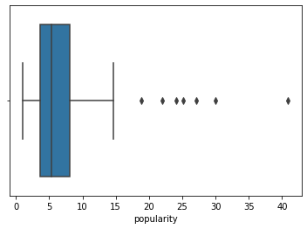

Data processing Bias
● Distribution Understanding
The popularity distribution per year and genre slightly skewed into the right and have outliers.
To overcome the outlier we calculate the Interquartile range to find the lower and upper bound and remove any number above it or below it. Sklearn Quantile Transformer for the skewness in the data
mean 7.240
std 6.524
min 0.994
25% 3.637
50% 5.349
75% 8.074
max 40.913
IQR: 4.437677941497093
Upper bound : 14.730898650617732
Lower bound : -3.019813115370639

Slide 27
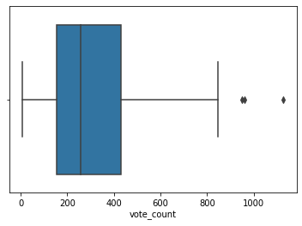

Data processing Bias
● Distribution Understanding
The vote count distribution per year and genre skewed into the right and have outliers.
To overcome the outlier we calculate the Interquartile range to find the lower and upper bound and remove any number above it or below it. Sklearn Quantile Transformer for the skewness in the data
Mean 315.300
std 253.289
min 6.643
25% 152.966
50% 257.875
75% 430.600
max 1126.804
IQR: 277.6341463414634
Upper bound : 847.0512195121951
Lower bound : -263.48536585365855

Slide 28
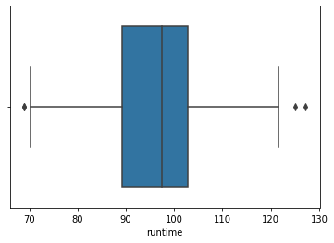

Data processing Bias
● Distribution Understanding
The runtime distribution per year and genre is slightly skewed into the left and have outliers.
To overcome the outlier we calculate the Interquartile range to find the lower and upper bound and remove any number above it or below it. Sklearn Quantile Transformer for the skewness in the data
mean 96.416
std 11.336
min 68.925
25% 89.322
50% 97.504
75% 102.833
max 127.200
IQR: 13.511534025374857
Upper bound : 123.10063437139561
Lower bound : 69.05449826989619

Slide 29
Data Insight Bias

Slide 30
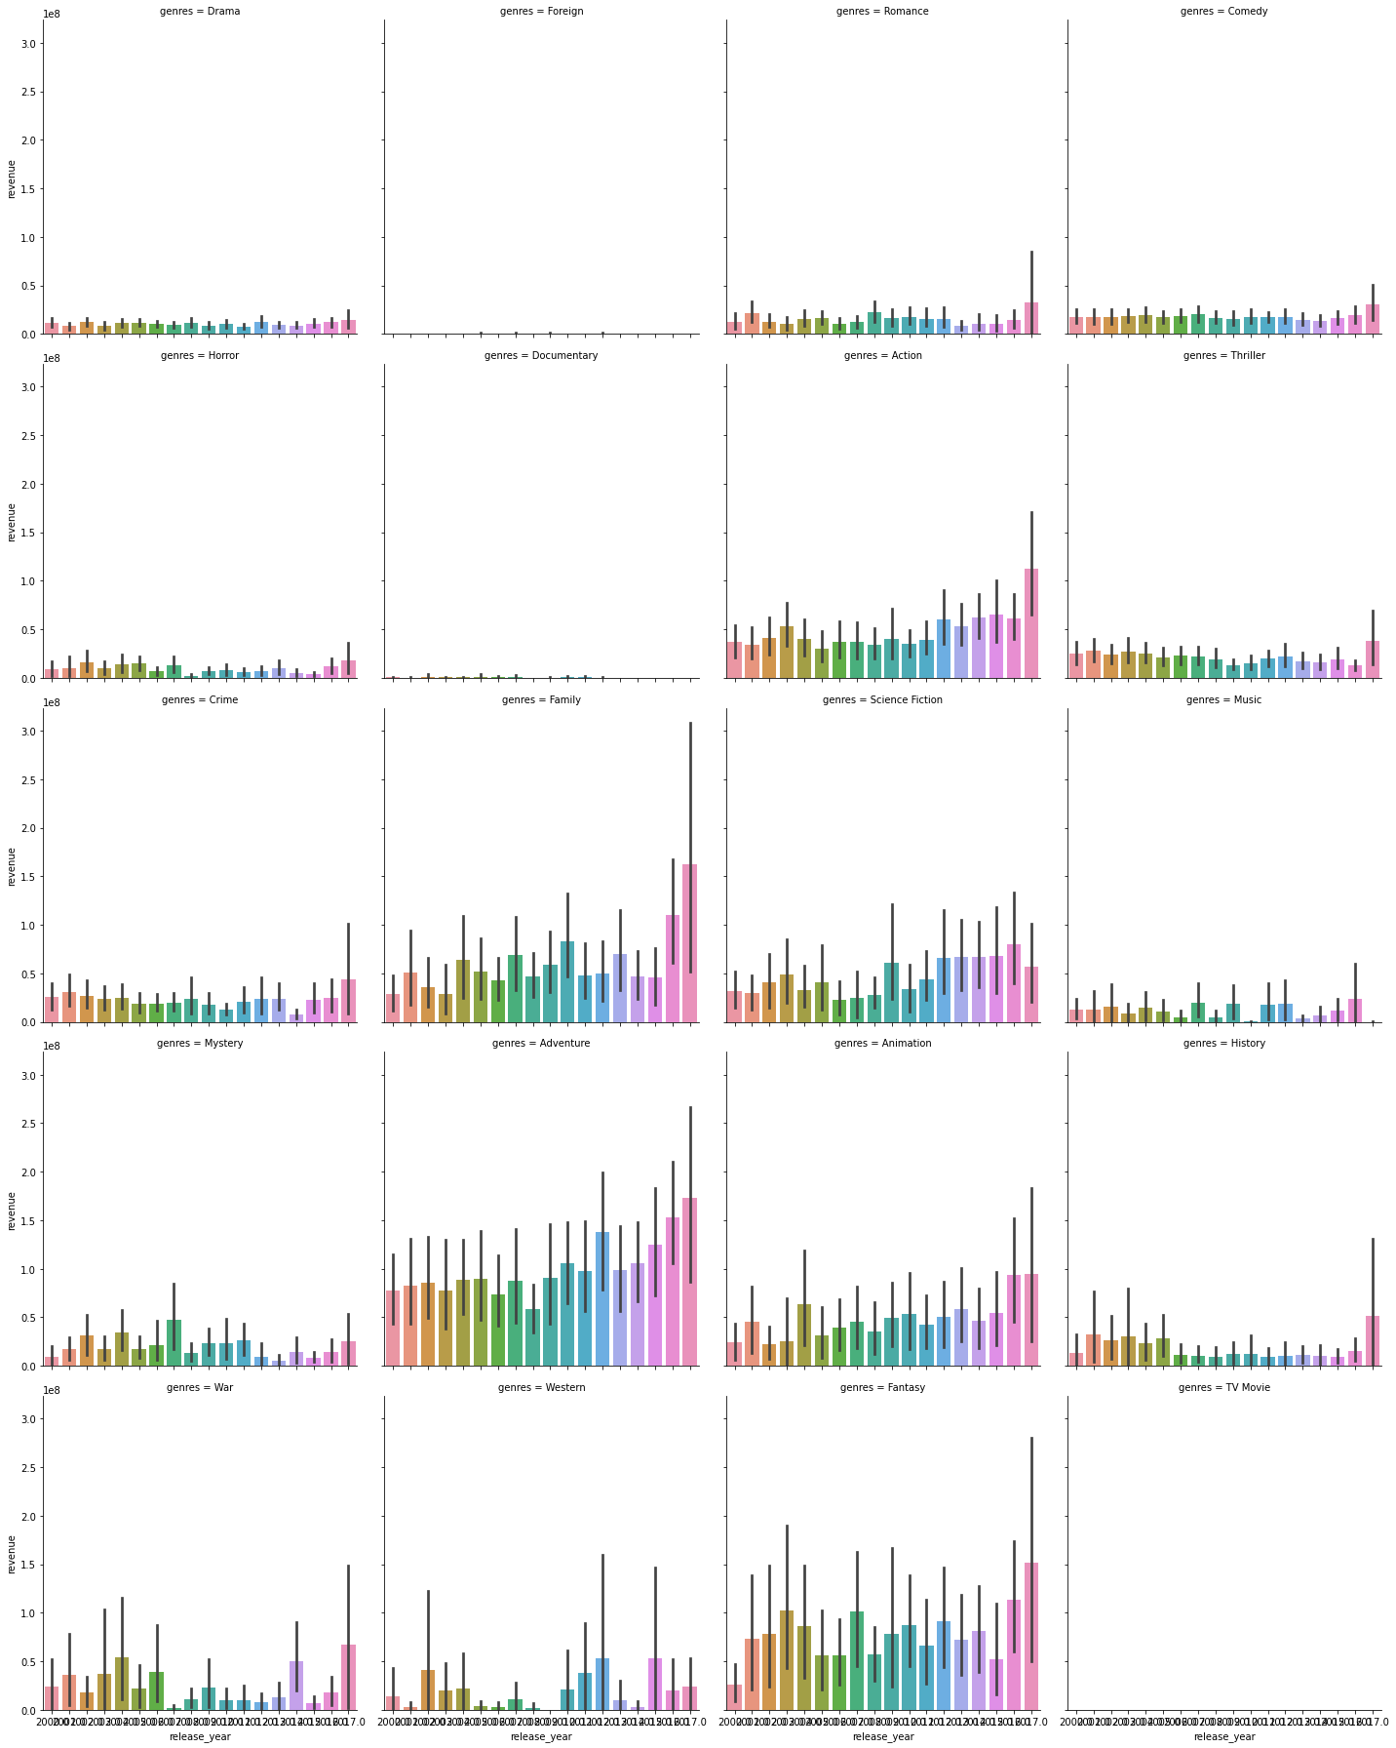
Confirmation Bias
As we see in the graph that the revenue changed through the last 20 years at least, thus we only focus on the last five years in the data

Slide 31
Next step recommendation
Genres like Foreign' TV Movie' and documentary have very low revenue during the years 2013 to 2017
When releasing movies with any genre, make sure there is enough budget and make an advertising campaign for the movie to receive revenue.

